Slide 1
NumPy Multiplication
Nan

Slide 2
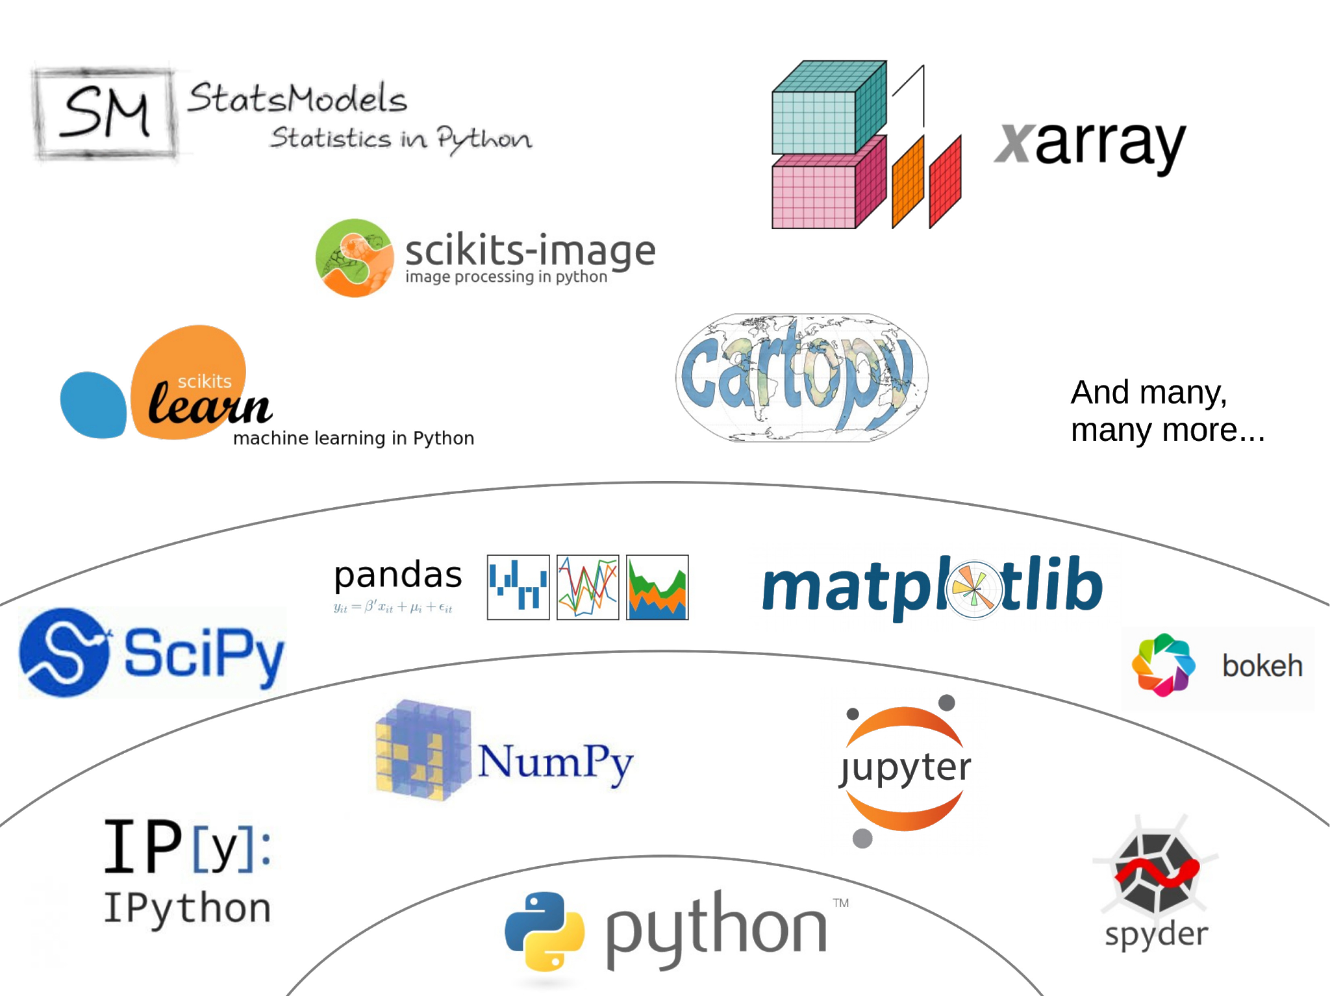
Why NumPy

Slide 3
95%
of the AI Engineers claim they know numpy well

Slide 4
Quiz Time!

Slide 5
1 * 2 = ?
Case 1 - Scalar
a = 1
b = 2
a * b = ?
np.multiply(a, b) = ?
np.dot(a,b) = ?
a @ b = ?
np.matmul(a,b)

Slide 6
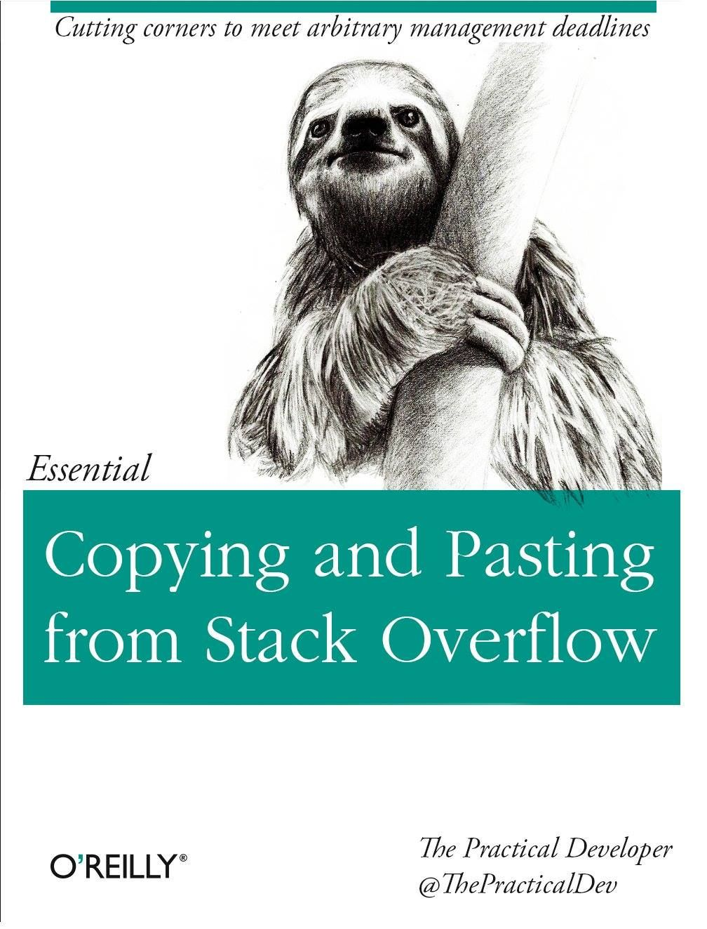
Key point
matmul differs from dot in two important ways.
Multiplication by scalars is not allowed.
Stacks of matrices are broadcast together as if the matrices were elements.

Slide 7
[1,2] * 3 = ?
Case 2 - 1D & scalar
a = [1, 2]
b = 3
a * b = ?
np.multiply(a, b) = ?
np.dot(a,b) = ?
np.array(a) * b
a @ b = ?
np.matmul(a,b)
np.array(a).shape
np.array(a)[:,None].shape
np.matmul(np.array(a)[:,None], [b])

Slide 8
Getting interesting

Slide 9
[x, y] * [m, n]
Case 3 - 1D & 1D
a = [1, 2]
b = [2, 3]
c = [3, 4, 5]
a * b = ?
a * c = ?
np.multiply(a, b) = ?
np.dot(a,b) = ?
np.array(a) * b
a @ b = ?
np.matmul(a,b)

Slide 10

Key points
Careful about broadcasting.
Though we don’t care normally, np.array is different from np.asarray.
Good practice to convert numerical python list to numpy array first.

Slide 11
More fun to come

Slide 12
[[x, y], [p, q]] * [m, n]
Case 4 - 2D & 1D
a = np.array([[1,2], [3,4]])
b = np.array([5,6]
a * b = ?
np.multiply(a, b) = ?
np.dot(a,b) = ?
a.dot(b) = ?
b.dot(a) = ?
b @ a

Slide 13
Error is good

Slide 14
[[x, y], [p, q]] * [[m, n], [u, v]]
Case 5 - 2D & 2D
a = np.array([[1,2], [3,4]])
b = np.array([[5,6], [7,8]])
a * b = ?
np.multiply(a, b) = ?
np.dot(a,b) = ?
b @ a
Case 6 - 2D & 2D
a = np.matrix([[1,2], [3,4]])
b = np.matrix([[5,6], [7,8]])

Slide 15
[[x, y], [p, q], [u, v]] * [[m, n]]
Case 7 - 3D & 1D
a = np.array([[[1,2,3], [2,3,4]], [[3,4,5], [4,5,6]]])
b = np.array([1,2,3])
a * b = ?
a.dot(b)
a @ b
Case 8 - 1D & 3D
c = np.array([1,2])
b * a = ?
c.dot(a)
c @ a

Slide 16
Getting real

Slide 17
[[x, y], [p, q], [u, v]] * [[m, n], [i, j]]
Case 9 - 3D & 2D or 2D & 3D
a = np.arange(12).reshape((2, 2, 3))
b = np.arange(6).reshape((3,2))
a * b = ?
a * b.T = ?
a.dot(b)
a @ b
b.T * a = ?
b.dot(a)
b @ a

Slide 18

Key points
np.dot and np.matmul behavior differently when it comes to ND array
matmul -> Stacks of matrices are broadcast together as if the matrices were elements.
It only treats last 2 columns as matrix and do 2D matrix multiplication
dot -> it is a sum product over the last axis of a and the second-to-last of b

Slide 19
One last example
Case 10
a = np.random.rand(2,2,2)
b = np.random.rand(2,2)
a @ b
a.dot(b)
b @ a
b.dot(a)
Both return results.
It might introduces errors that you have a hard time to debug.

Slide 20
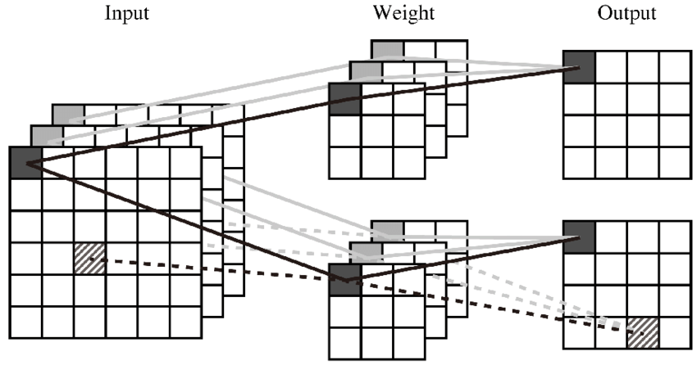
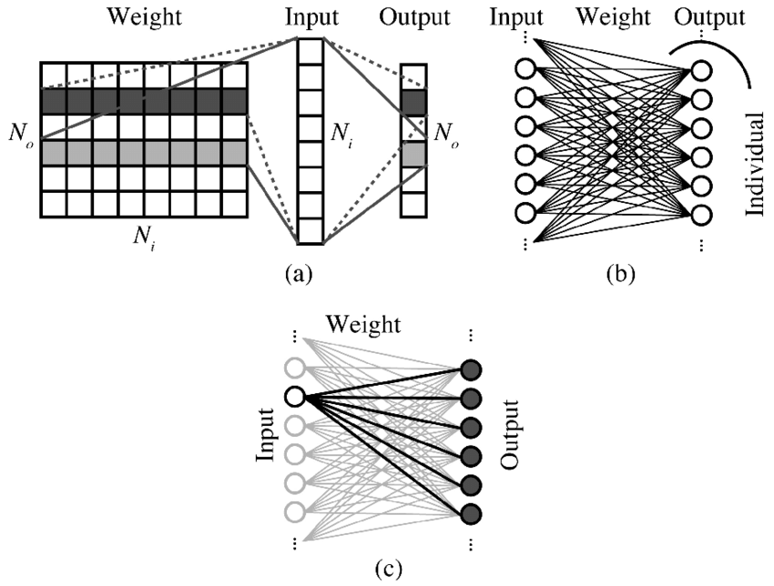
… yet another example

Slide 21

Takeaway
Always know what you are doing

Slide 22
“If you torture the data long enough,
it will confess.”
- Ronald Coase

Slide 23

Thanks!
Made in rush with ❤️@ AI Lab
by Nan
<xiao.n@outlook.com>

